Slide 1
Single Cell Data Analysis
CMM262-2018
Emily Wheeler
ecwheele@ucsd.edu

Slide 2
General Workflow:
Goals:
Determine which cells are most similar to each other
Identify the features (genes) that separate the groups of cells
Workflow:
Filter for good cells and detected genes (arbitrary cutoffs)
Scale Data (TPM, z-score each gene across all cells)
Remove unwanted sources of variation (batch)
Select most variable genes (optional)
Perform PCA and identify components that capture significant signal in the data
Graph-based clustering of cells based on PCA eigenvectors
Ignoring non-varying signal in the clustering
Visualize results in 2-D space (TSNE)
Define Cell-Type specific signatures
Differential expression between each pairwise combination of clusters

Slide 3
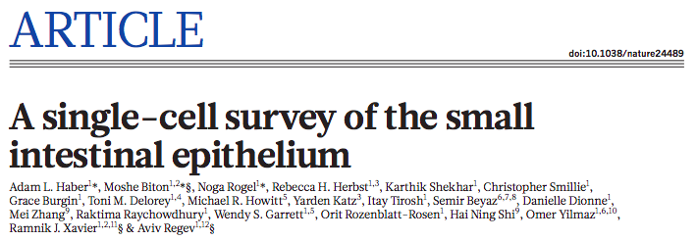
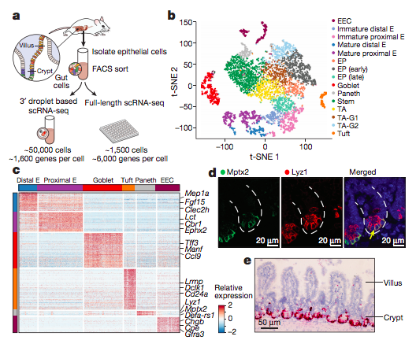

Slide 4
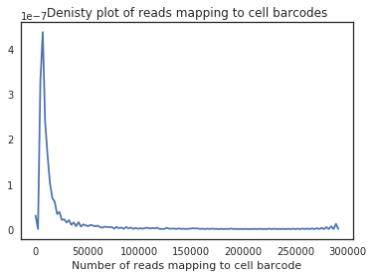
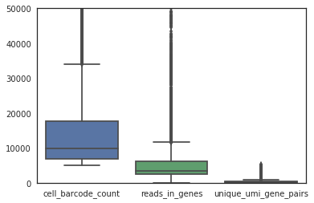
Filtering for high quality cells:
Decide which cell barcodes to include for downstream analyses
Mapping percentage per barcode and PCR duplication rates

Slide 5
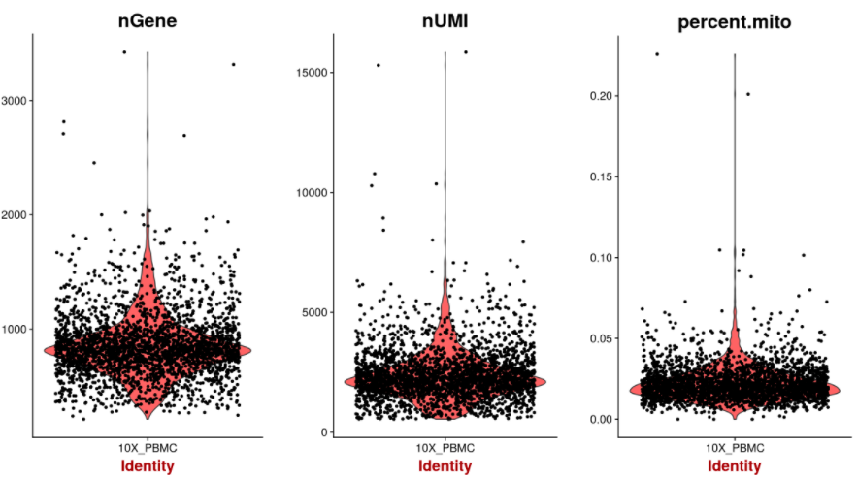
Remove outlier cells

Slide 6
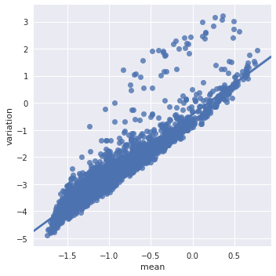
Normalize, Select variable genes, and z-score for scaling
How do you normalize for sequencing depth?
Should you normalize for sequencing depth in single cell data?
Is Length an important normalization step here?
Brennecke et al. 2013 Nature Methods

Slide 7
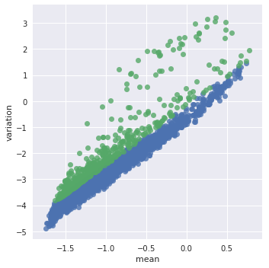
Normalize, Select variable genes, and z-score for scaling
How do you normalize for sequencing depth?
Should you normalize for sequencing depth in single cell data?
Is Length an important normalization step here?
Brennecke et al. 2013 Nature Methods

Slide 8
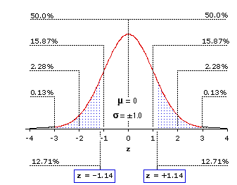
Z-score scaling:
Zscore is the number of standard deviations away from the mean
Purpose is to scale expression of each gene relative to all the cells
What is the expected sum of all z-scores for a given gene?

Slide 9
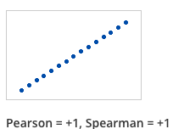
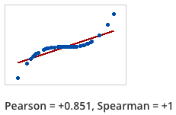
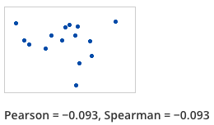
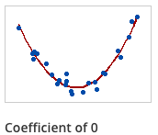
Pearson vs Spearman correlation
Pearson Correlation: For every increase in x, is there a constant, proportional increase in y?
Spearman Correlation: Rank based. If x increases, does y also increase
(magnitude doesn’t matter)

Slide 10
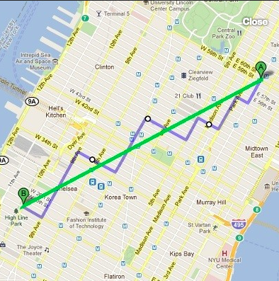
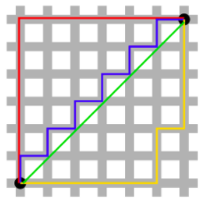
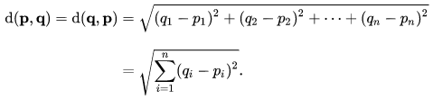
Distance metrics for “similarity” (Euclidean and Manhattan)
Euclidean: shortest distance between two points
Manhattan: distance when only moving along x or y axis
Distance is scaled to N dimensional vectors for lots of cells and genes
Two cells with 500 genes in each contain 500 distances to measure for overall similarity

Slide 11
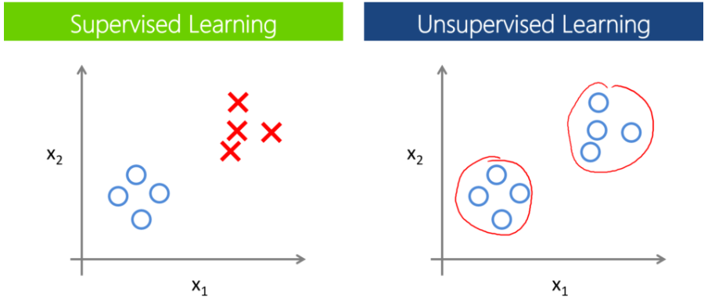
Clustering: Supervised vs unsupervised
Supervised:
Have prior knowledge of the groups
Unsupervised:
Have no prior knowledge of the data
Looking for substructure to find new patterns

Slide 12
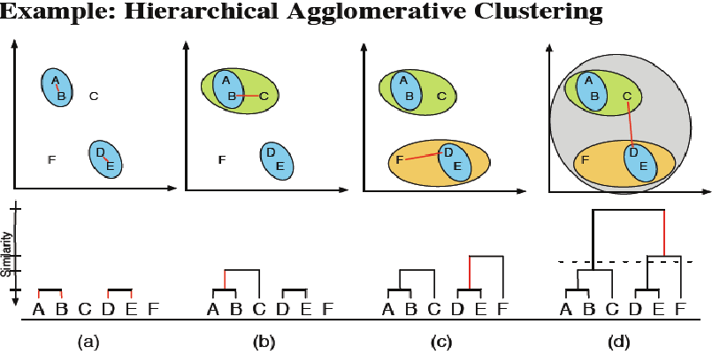
Hierarchical Clustering:
Grouping cells together based on similarity
Bottom up: Start with individual points and add most similar data points
Top down: Start with one big group, and drop out one at a time based on similarity
Cluster groups are defined based on your chosen similarity metric
https://www.researchgate.net/figure/Example-of-hierarchical-clustering-clusters-are-consecutively-merged-with-the-most_273456906

Slide 13
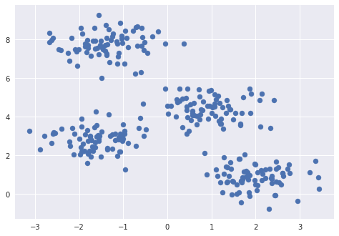
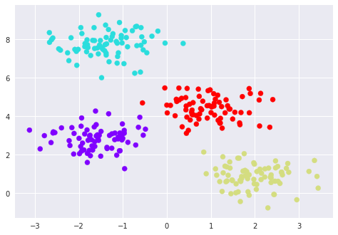
K-means clustering
How many clusters exist in this dataset?
Randomly assign points to guess the cluster centers (number of points = k)
Assign datapoints to the nearest cluster center.
Move the cluster assignment to the mean of each group
Repeat
http://stanford.edu/class/ee103/visualizations/kmeans/kmeans.html

Slide 14
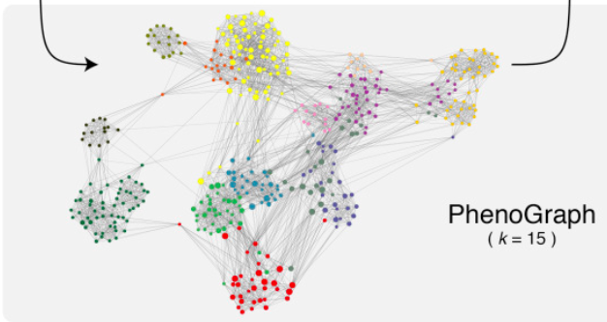
Graph-based clustering (k-nearest neighbors)
Levine et al. 2015 Cell

Slide 15
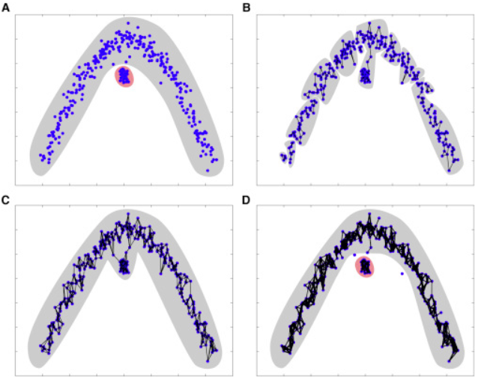
Graph-based clustering (k-nearest neighbors)
Measure Euclidian distances between cells up to K nearest neighbors (edges)
Weight of edges scales with similarity metric (euclidian distance)
Calculate “connectedness” of nodes (cells) by the number of shared neighbors
Refine densely connected modules as communities

Slide 16
k=5
Assign Modularity
k=10
Notes:
A – simulated data
B – KNN graph with k=5
C – KNN graph with k=10
D – jaccard index to assign modularity

Slide 17
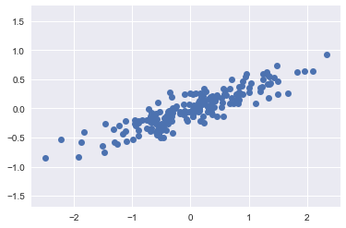
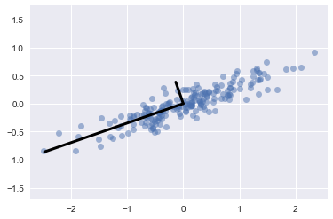
Dimensionality Reduction (PCA)
PCA:
Identifies linear components of variation within the dataset

Slide 18
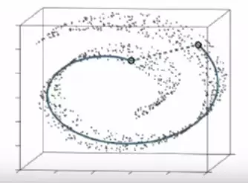
Dimensionality Reduction (tSNE)
tSNE:
Handles non-linear and sparse data very well
Preserves local relationships in high dimensional space

Slide 19
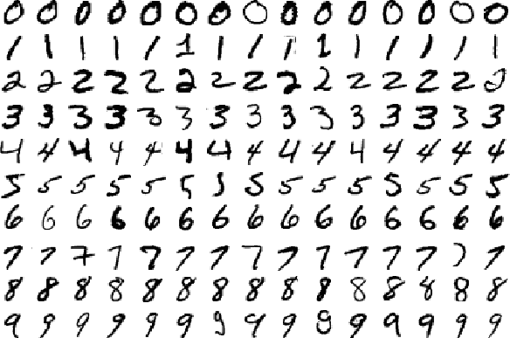
PCA and tSNE application to digits:

Slide 20
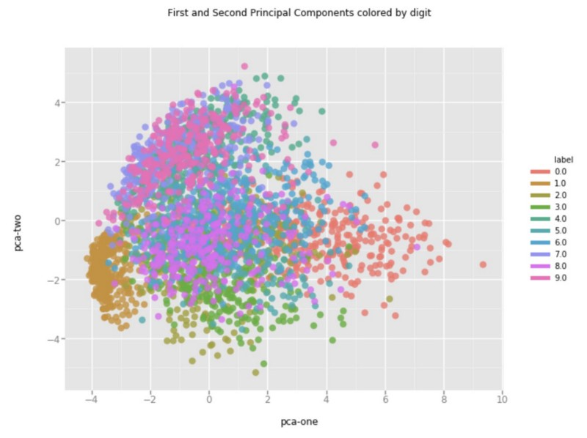
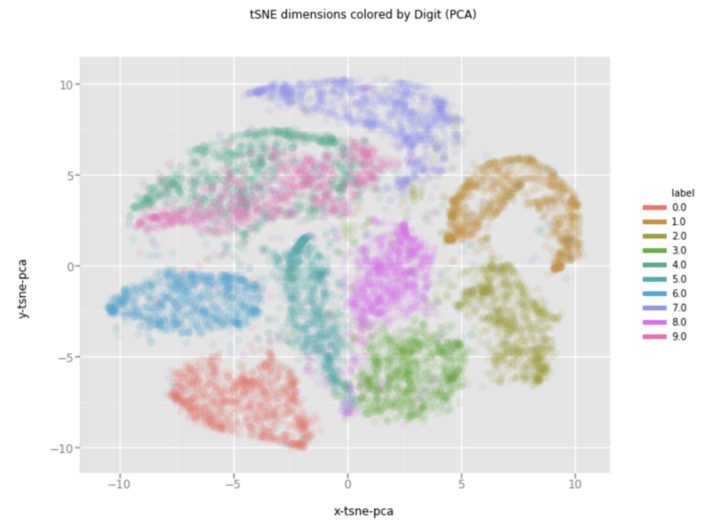
PCA and tSNE application to digits
PCA
tSNE

Slide 21
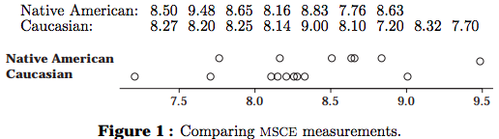

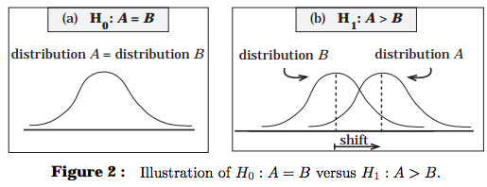
Wilcoxin rank-sum test (Mann Whitney U test)
Rank-based t-test (data is not normally distributed)
Chris Wild, University of Aukalnd
https://www.stat.auckland.ac.nz/~wild/ChanceEnc/Ch10.wilcoxon.pdf

Slide 22
Bonferonni correction for multiple hypothesis testing
If we perform 1000 tests (1000 genes) and accept a p-value < 0.05, how many tests will be incorrect?
Bonferroni correction (very stringent)
Multiply the resulting p-values by the number of tests performed

